Slide 1
EECS 230 Deep Learning
Projects

Slide 2
Course Projects
At most two students for each project
Midterm report (Up to2 pages excluding reference)
Project proposal
Preliminary results
Final project presentation (10 minutes + 2 minutes Q/A)
Final project report (Up to 8 pages excluding reference)
Can choose your own research project
Alternatively, a list of projects provided
> Just running open-source code
< research project

Slide 3
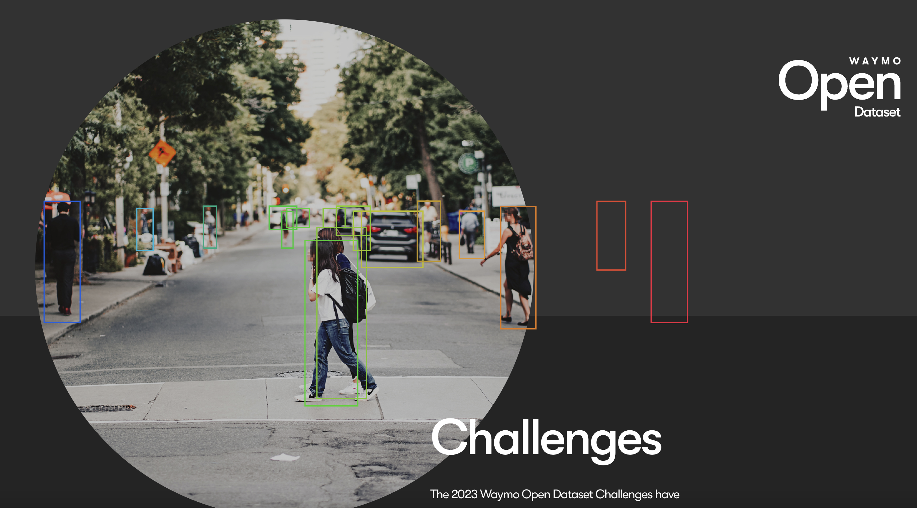
Project idea #1
Goal: 2D or 3D Perception on Waymo Open Dataset
2D/3D Detection, Segmentation, or tracking
Using Image, 3D Lidar, or both.

Slide 4
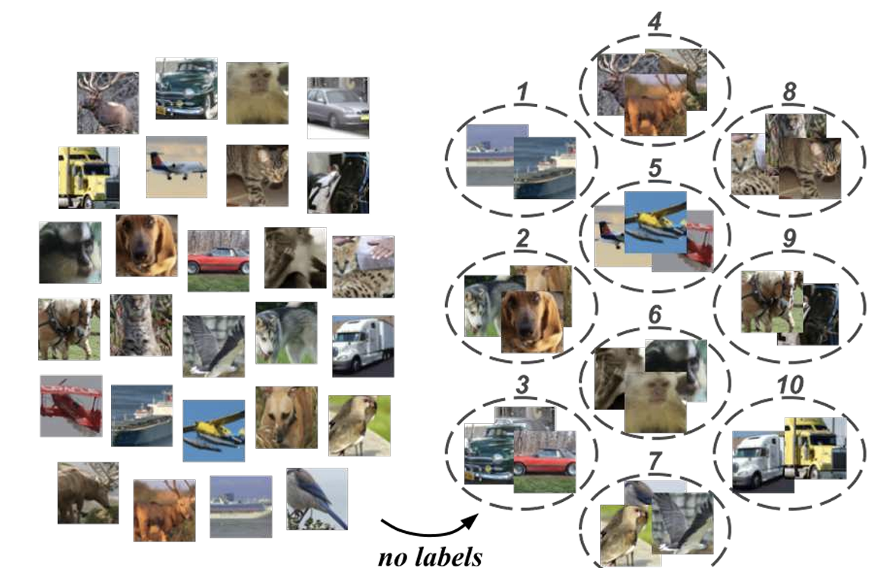
Project idea #2
Goal: Unsupervised Image Clustering Using Deep Learning
Related paper:
Ji, Xu, Joao F. Henriques, and Andrea Vedaldi. "Invariant information clustering for unsupervised image classification and segmentation." ICCV. 2019.

Slide 5
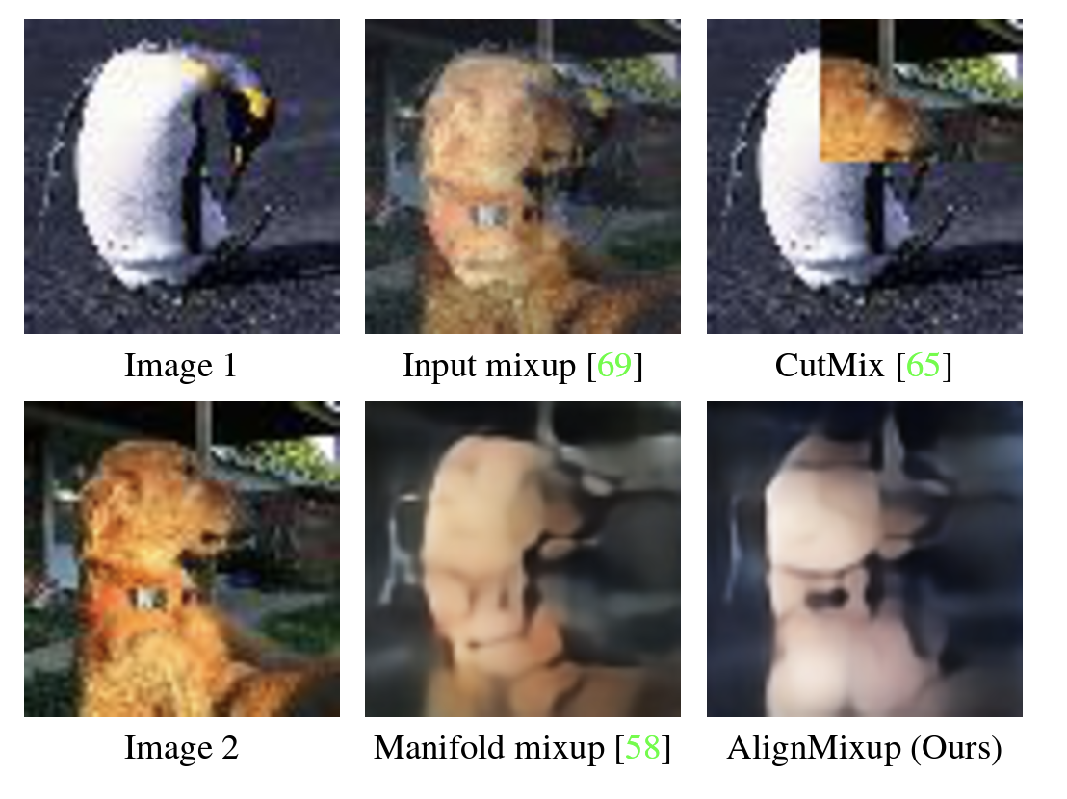
Project idea #3
Goal: Image Interpolation for Mixup Data Augmentation
Related paper:
Venkataramanan, Shashanka, et al. "Alignmixup: Improving representations by interpolating aligned features." CVPR. 2022.
Manifold mixup https://proceedings.mlr.press/v97/verma19a/verma19a.pdf
How to utilize diffusion model for image interpolation?
DiffAE
Interpolation
SmoothDiffusion

Slide 6
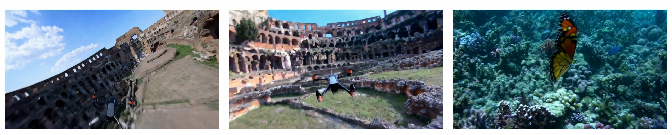
Project idea #4
Goal: Video Interpolation using Existing Generative Model
Related work:
OpenAI Sora https://openai.com/research/video-generation-models-as-world-simulators

Slide 7
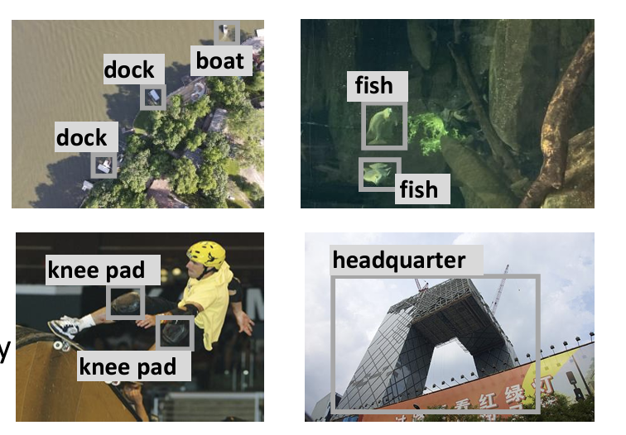
Project idea #5
Goal: Open Vocabulary Object Detection
Related paper:
Wang, Zhenyu, et al. "Detecting everything in the open world: Towards universal object detection." CVPR. 2023.

Slide 8
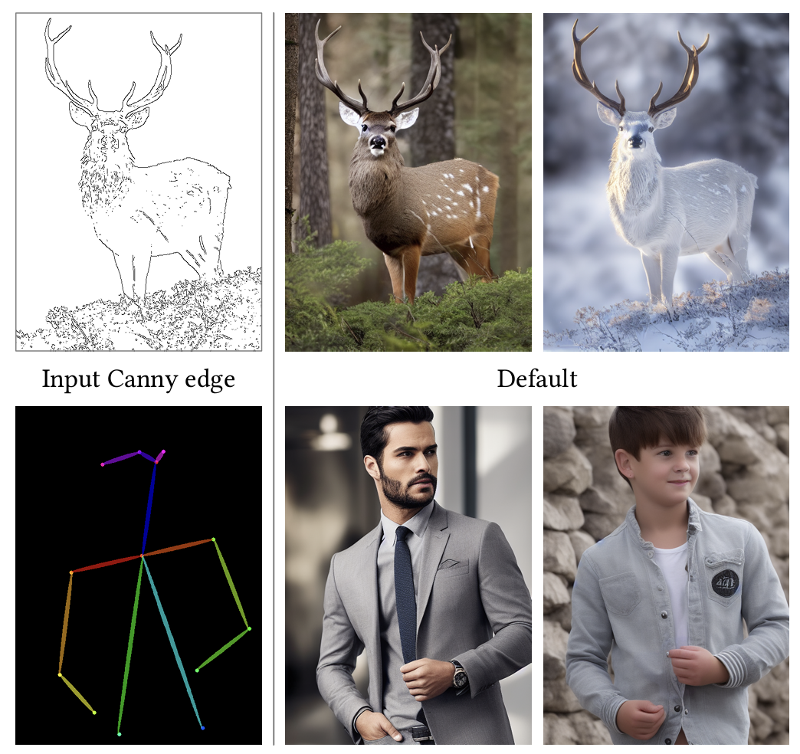
Project idea #6
Goal: Conditional Image Synthesis
Related paper:
ControlNet: https://arxiv.org/abs/2302.05543
Training requires a lot of GPU hours!

Slide 9
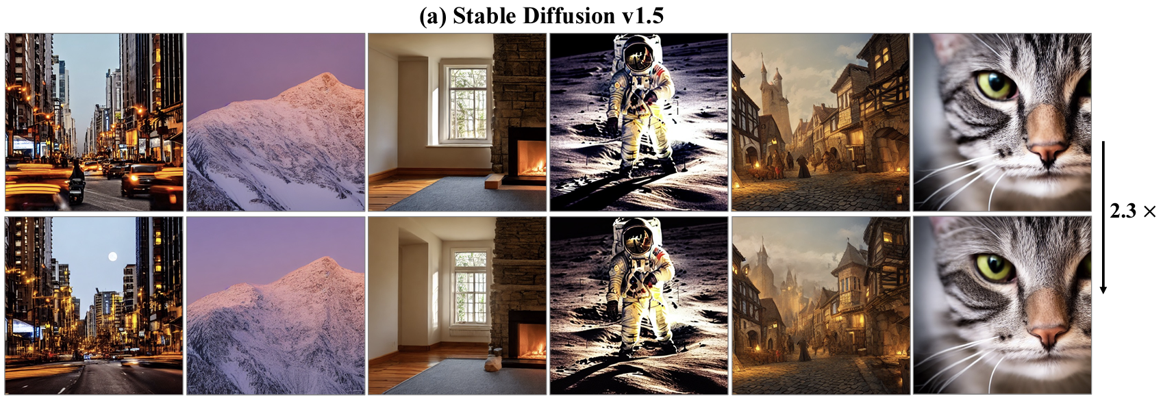
Project idea #7
Goal: Accelerate Inference of Diffusion Model for Image Synthesis
Related paper
DeepCache: https://arxiv.org/pdf/2312.00858.pdf

Slide 10
Project idea #8
Goal: Network Quantization for Diffusion Model
Related paper
Shang, Yuzhang, et al. "Post-training quantization on diffusion models." CVPR. 2023.

Slide 11
Project idea #9
Goal: Finetune Open-source Large Language Model
Turn a generalist into a specialist
Related paper:
Instruct-GPT: Ouyang, Long, et al. "Training language models to follow instructions with human feedback." NeurIPS (2022)
LoRA: https://arxiv.org/abs/2106.09685

Slide 12
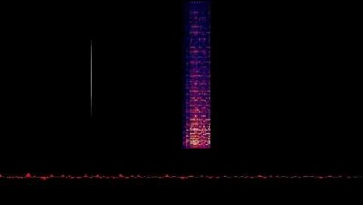
Project idea #10
Goal: Train a transformer network for music generation
Related paper:
Hawthorne, Curtis, et al. "General-purpose, long-context autoregressive modeling with perceiver ar." International Conference on Machine Learning, 2022.
https://storage.googleapis.com/perceiver-ar/index.html
Code: https://huggingface.co/krasserm/perceiver-ar-sam-giant-midi

Slide 13
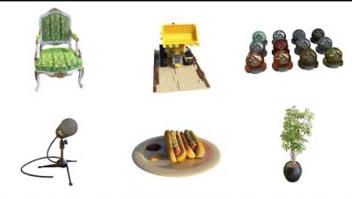
Project idea #11
Goal: Neural Radiance Field for Objects of Your Choice
Related paper:
Mildenhall, Ben, et al. "Nerf: Representing scenes as neural radiance fields for view synthesis." Communications of the ACM 65.1 (2021).

Slide 14
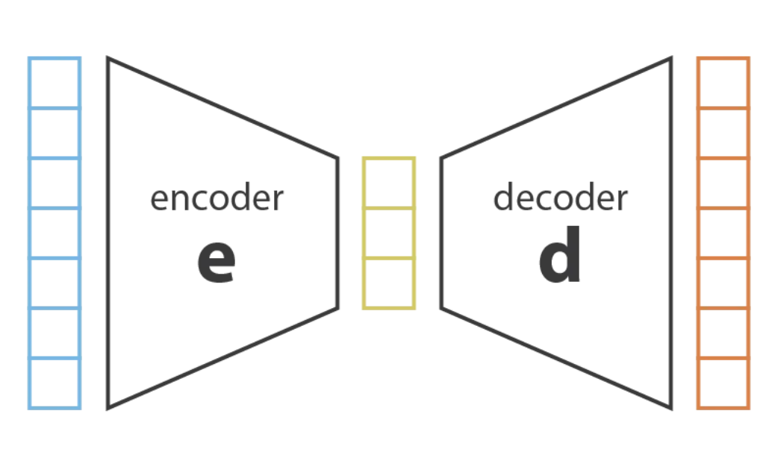
Project idea #12
Goal: Class-imbalanced Variational Auto-encoder
Improve VAE for long-tailed dataset, utilize contrastive learning losses

